Slide 1
C♯ Design Patterns in Practice
Rasmus Lystrøm
Associate Professor
ITU
rnie@itu.dk

Slide 2
Agenda
Webinar on Entity Framework 5
Design Patterns in practice

Slide 3
PREPARING YOUR MOVE TO ENTITY FRAMEWORK CORE 5: WHAT’S NEW AND WHAT’S IMPROVED Thursday, October 29 1:00 pm ET | 12:00 pm CT | 11:00 MT
https://go.pluralsight.com/C0098511

Slide 4
Design Patterns
IoC Container
Builder
Adapter
Factory Method
Singleton
Iterator
Façade
Chain of Responsibility
Strategy
Bridge
Saved for later:
Command (MVVM)
Observer (MVVM)
Proxy (Web API)

Slide 5
IoC Container
Tool to facilitate dependency injection.
Using a factory to either manually or automatically create types at runtime.
Various implementations:
Microsoft.Extensions.DependencyInjection
Ninject
Unity
AutoFac
StructureMap

Slide 6
IoC Container II
Lifetime:
Transient
Scoped
Singleton
Lifetime:
Transient (every time)
Scoped (once per request)
Singleton (once)

Slide 7
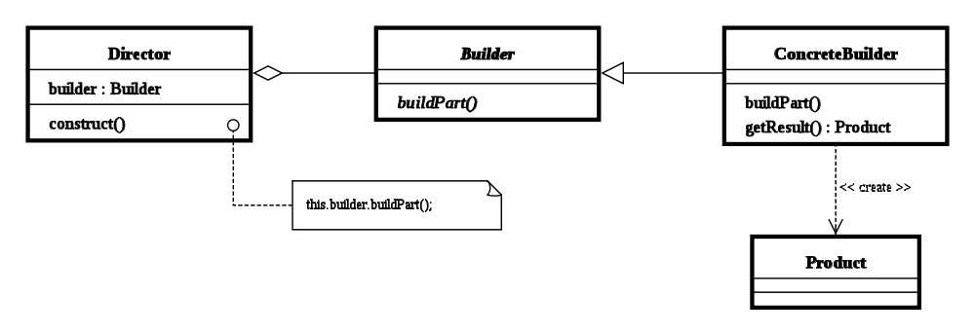
Builder
Separate the construction of a complex object from its representation
serviceCollection.AddScoped<,>();
serviceCollection.BuildServiceProvider();

Slide 8
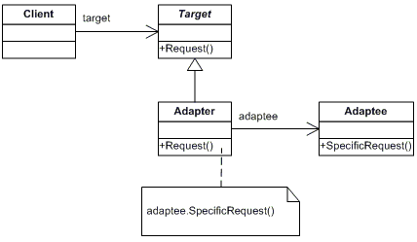
Adapter aka Wrapper
Unmodifiable implementation which does not match the interface you need.
Static or sealed class or class in another assembly.

Slide 9
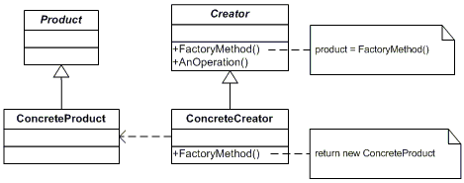
Factory Method
A method which can creates instances of a given type.

Slide 10
Singleton
Only ever one single instance of a given type.
Considered an anti-pattern by many, it:
is overused
introduces unnecessary restrictions in situations where a sole instance of a class is not actually required
introduces global state into an application

Slide 11

Singleton II
Use carefully
Implement using an interface
Use an IoC container

Slide 12
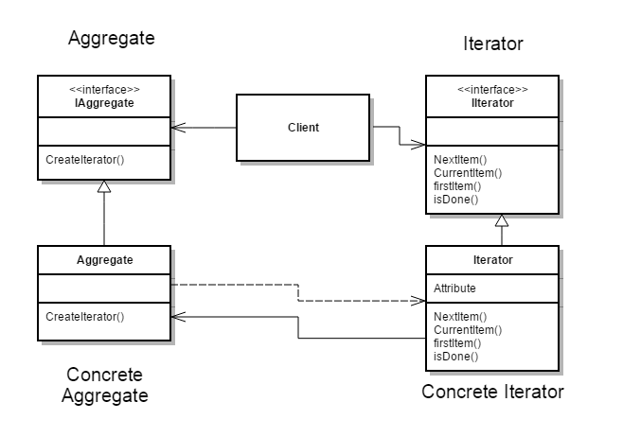
Iterator
Provide a way to access the elements of an aggregate object (collection) sequentially without exposing the underlying representation
IEnumerable
IEnumerable<T>
IEnumerator
IEnumerator<T>
foreach...

Slide 13
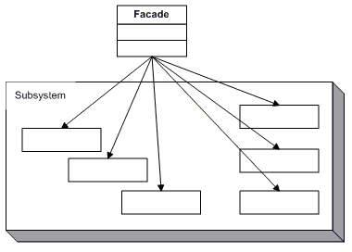
Façade
Simplify the use of a system
Provide a uniﬁed interfaces for a group of “dispersed” functionalities from a multitude of interfaces/classes

Slide 14
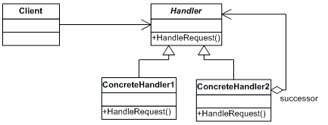
Chain of Responsibility
Avoid coupling the sender of a request to its receiver by giving more than one object a chance to handle the request. Chain the receiving objects and pass the request along the chain until an object handles it.

Slide 15
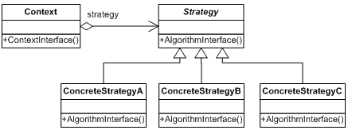
Strategy
Define a family of algorithms, encapsulate each one, and make them interchangeable. Strategy lets the algorithm vary independently from clients that use it.

Slide 16
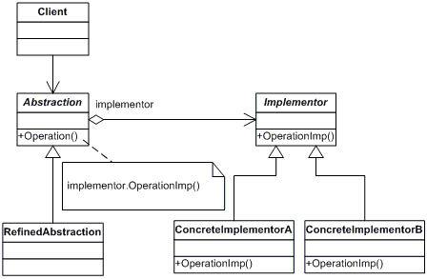
Bridge
Decouple an abstraction from its implementation so that the two can vary independently.

